Slide 1
Genetic algorithms

Slide 2
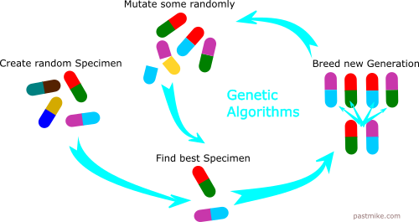
How does it work?

Slide 3
Basic functions required to implement
np.random.rand(d1, d2, …) # generate array with random numbers between 0 and 1
np.random.randint(n) # generate integer from 0 to n-1
np.copy(array) # copy an array
np.zeros_like(other_array) # make empty array with same shape as the other array
np.argsort(array) # return array of indexes of sorted array
>>> x = np.array([3, 1, 2])
>>> np.argsort(x)
array([1, 2, 0])

Slide 4
When to use them
Trying to find the best combination of values for something
Can’t calculate the result
To many possibilities to try

Slide 5
Possible applications
Scheduling
Trains
Schools
Floor layouts
Factories
Power plant
Engineering designs
Semiconductors
Antennas
Resource allocation

Slide 6
Training neural network weights with a genetic algorithm
Network doesn’t have to be differentiable
Can handle cost functions with complex rules and constraints without any alterations

Slide 7
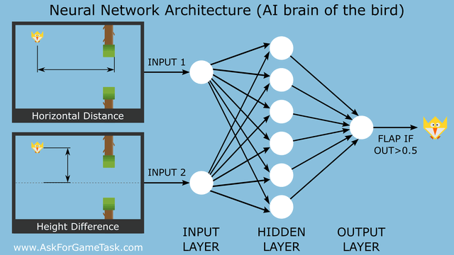
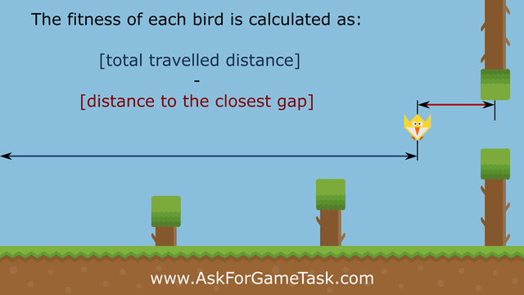
Machine Learning for Flappy Bird

Slide 8
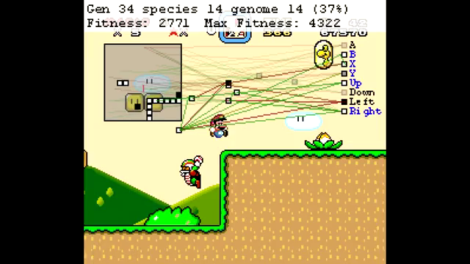
MarI/O

